Slide 1
RIP FOR 2 ROUTER
Steps to Configure and Setup RIP FOR 2 ROUTER in Cisco Packet Tracer :
Step 1: First, open the cisco packet tracer desktop and select the devices
Add 2pc pr laptop(pc0,pc1)
Add 2 switches(switch0,switch1)
Add 2 routers(router0,router1)
step2:-Add automatical wire to pc to switches and switches to router viceversa.
Step3:- add ip address to pc for 192.168.1.10/24 and 192.168.2.10/24
Step4:- Add interface configurstion for router and rip configuration for routers.

Slide 2
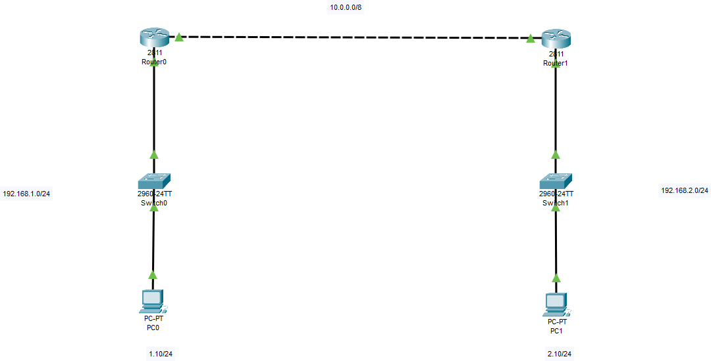
RIP configuration for Router R1 – interface FA0/0
Router>en Router#conf t
Enter configuration commands, one per line. End with CNTL/Z. Router(config)#int fa0/0
Router(config-if)#ip add 192.168.1.1 255.255.255.0 Router(config-if)#no shut
Router(config-if)#
%LINK-5-CHANGED: Interface FastEthernet0/0, changed state to up
%LINEPROTO-5-UPDOWN: Line protocol on Interface FastEthernet0/0, changed state to up
^Z Router#
%SYS-5-CONFIG_I: Configured from console by console
Router#wr
Building configuration... [OK]
Router#
RIP configuration for Router R1 – interface 0/1
Router#en Router#conf t
Enter configuration commands, one per line. End with CNTL/Z. Router(config)#int fa0/1
Router(config-if)#ip add 10.0.0.1 255.0.0.0 Router(config-if)#no shut
Router(config-if)#
%LINK-5-CHANGED: Interface FastEthernet0/1, changed state to up

Slide 3
Router(config-if)# Router#
%SYS-5-CONFIG_I: Configured from console by console
Router#wr
Building configuration... [OK]
Router#
RIP configuration for Router R2 – interface FA0/0 & FA0/1
Router>en Router#conf t
Enter configuration commands, one per line. End with CNTL/Z. Router(config)#int fa0/0
Router(config-if)#ip add 192.168.2.1 255.255.255.0 Router(config-if)#no shut
Router(config-if)#
%LINK-5-CHANGED: Interface FastEthernet0/0, changed state to up
%LINEPROTO-5-UPDOWN: Line protocol on Interface FastEthernet0/0, changed state to up
Router(config-if)#exit Router(config)#int fa0/1
Router(config-if)#ip add 10.0.0.2 255.0.0.0 Router(config-if)#no shut
Router(config-if)#
%LINK-5-CHANGED: Interface FastEthernet0/1, changed state to up
%LINEPROTO-5-UPDOWN: Line protocol on Interface FastEthernet0/1, changed state to up
Router(config-if)#exit Router(config)#

Slide 4
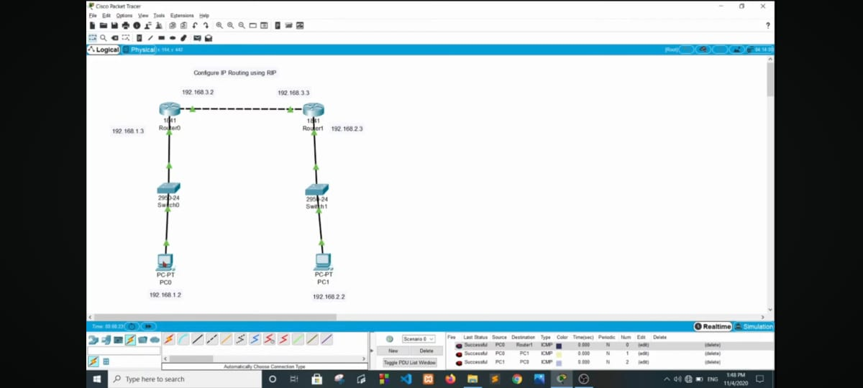
RIP Configurations on both R1 & R2 routers
Go to Router R1
Router#conf t
Enter configuration commands, one per line. End with CNTL/Z. Router(config)#router rip
Router(config-router)#network 192.168.1.0
Router(config-router)#network 10.0.0.0
Router(config-router)#^Z Router#
%SYS-5-CONFIG_I: Configured from console by console
Router#wr
Building configuration... [OK]
Router#
Go to Router R2
Router(config)# Router(config)#router rip
Router(config-router)#network 192.168.2.0
Router(config-router)#network 10.0.0.0
Router(config-router)#^Z Router#
%SYS-5-CONFIG_I: Configured from console by console
Router#wr
Building configuration... [OK]
Router#
After ping to pc it show succefully done.

